Slide 1
Node

Slide 2
Front End Framework Architecture
Node js
( Web Server )
IDE
Visual Studio
developer
VUE
React
SOURCE
result
Anguler
Support Tool
Web pack
(compress & compile)
Front End F/W 다운로드 수 통계 자료
https://2017.stateofjs.com/2017/front-end/results/
https://2018.stateofjs.com/data-layer/overview/

Slide 3
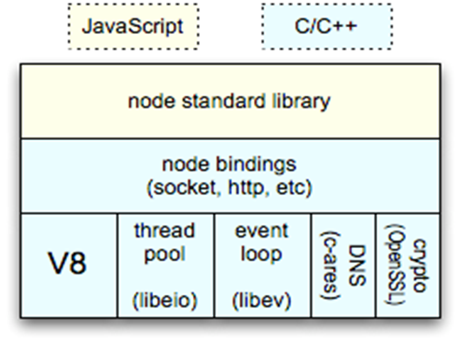
Node Core Module Architecture

Slide 4
Advantages of Node
V8 Engine Based Structure
javascript
powerful language
easy Learning curve
Socket IO
all platform powerful push function
Single Thread Based Event Loop
None Blocking IO

Slide 5
Advantages of Node
Blocking IO
file_write
(filename)
Request
1. 파일 쓰기 요청
Response
2. 파일 쓰는 중
( CPU 작동 안함 )
3. 파일 쓰기 끝남
Non-Blocking IO
file_async_write
(filename,callback)
Request
1. 파일 쓰기 요청
Response
2. 요청 하고 바로 리턴
3. 파일 쓰는 중
( CPU 작동 안함 )
4. 파일 쓰기 끝남을 알리는 이벤트
5. Callback 함수 호출

Slide 6
Advantages of Node
Multi Thread Model
Client A
Thread
Thread Pool
Client B
Thread
Thread Pool
- Size Limited
Client C
CPU
JOB
IO
Client C
CPU
JOB
IO
Client C
CPU
JOB
IO
request
BLOCKED
BLOCKED
BLOCKED
response
IO efficiency ( DB, Network, File )
- Thread is Not used Application , Status change Wait ( Idle Thread )

Slide 7
Advantages of Node
Single Thread Model
Client A
Client B
CPU
JOB
IO
JOB
EVENT ROOP THREAD
request
request
response
response
Client A
ELP
Thread
Thread
From Pool
Block IO
BLOCKED
Thread Pool
예제 file open OS에서 지원을 안 할 때
Thread Pool

Slide 8
Advantages of Node
Event loop
epoll, kqueue, dev/poll ,select
A
0.1
B
30
C
0.1
D
5
B
5.5+
Socket fd

Slide 9
Advantages of Node
Multi Thread Vs Single Thread
 | Multi Thread (He) | Single Thread (She)
Size Limit | Tomcat Default 500 Maximum 2000? | I Have No Idea
Thread efficiency | I'm awesome | Better than him
Request processing | No problem | If One request processing takes long time…? Slowly Server!

Slide 10
Advantages of Node
When shouldn't I use Node.js?
Fast Prototype
Api Server ( return To Json )
CRUD
Persistence ( mongodb, mysql )
File upload/download stream service
When should I not use node js?
Cpu-intensive application
A novice developer Because Single event loop
We need Good Code
Error Code All failer node Server ( hot deploy , option staging deploy )

Slide 11
Node Syntax Example
npm install --save-dev webpack webpack-cli
npm install –g webpack webpack-cli
npm install --save-dev @babel/core @babel/preset-env
npm install --save-dev react react-dom @babel/preset-react
npm install -g babel-preset-react
npm install -i babel-preset-react
npm install --save-dev html-webpack-plugin html-loader
npm install --g html-webpack-plugin html-loader
npm install vue --save npm install vue-loader vue-template-compiler -D
Npm Site
https://www.npmjs.com/products/enterprise

Slide 12
Node js
Npm.exe
Npm install --save-dev html-webpack-plugin html-loader
https://registry.npmjs.org/devdvdafsfd
Download
/npm_modules/devdvdafsfd
Npm
Git
Npmjs
Nexus
Id / pw
유료화
Maven
Pom.xml
jar
Maven repository
Apache repository
Gradle
class
10

Slide 13
김남 11년차
주력언어 java, python
( Application Architecture )
이다미 신입
FrontEnd , Backend Server
학교에서 웹 Spring STS IDE로 해봄
MVC 패턴 사용해봄
어노테이션 @Controller @Service @Repository
Mybatis로 해봄
Json data type
react 해봄 node는 해보지 않았음?
node npm
성범수 5년차
주력언어 java, javascript

